Slide 1
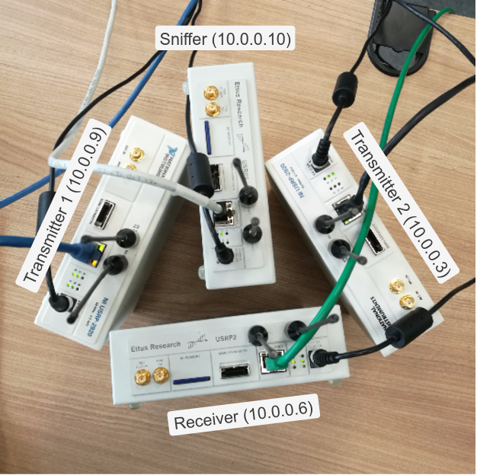
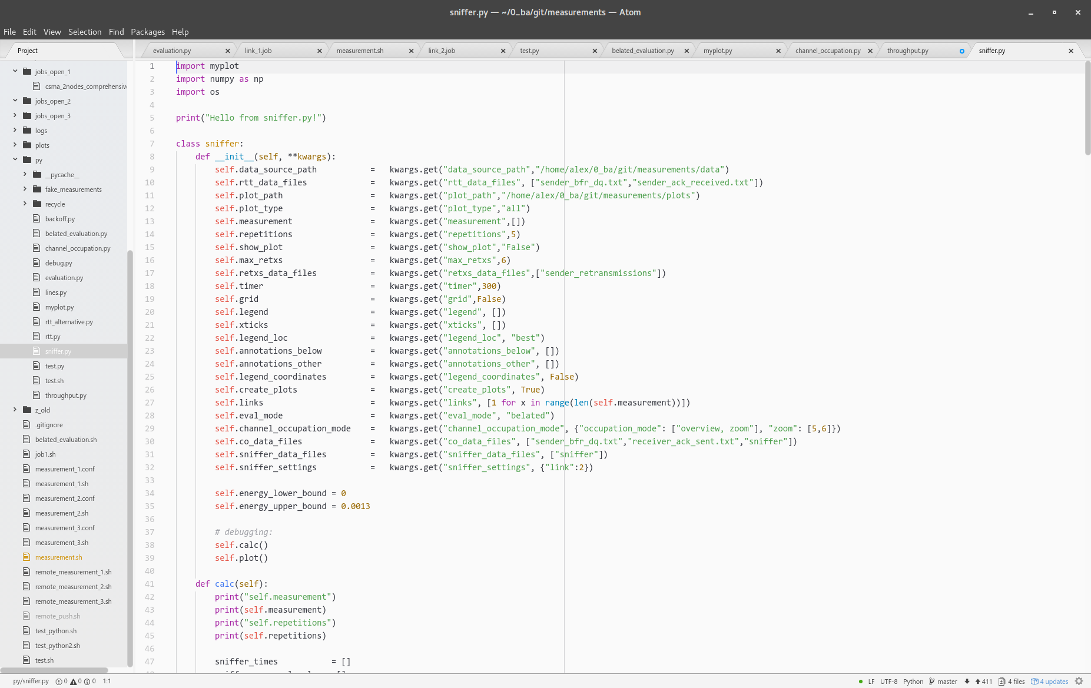
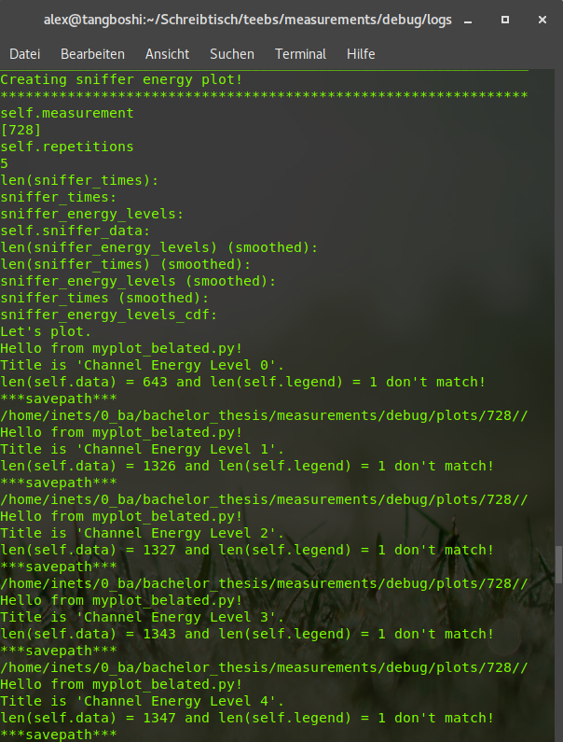

Coexistence Study of Different Medium Access Mechanisms Using a Software Defined Radio Testbed
Bachelor Thesis Talk
Alexander Pastor - December 18th, 2017
Notes:
Master slide:
Welcome audience to bachelor thesis presentation XMAS-Edition "Coexistence Study of Different Medium Access Mechanisms Using a Software Defined Radio Testebed"

Slide 2
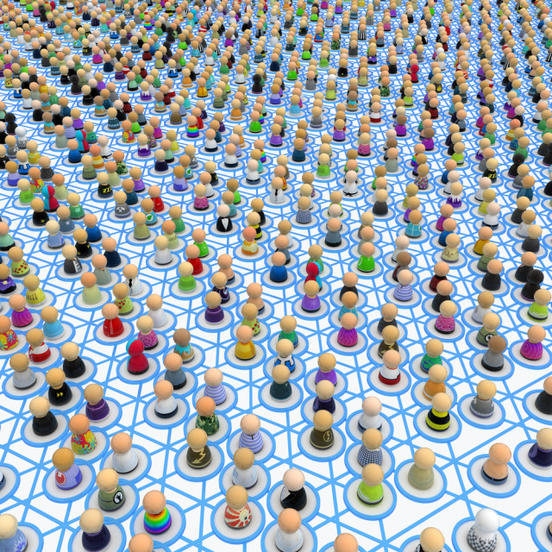
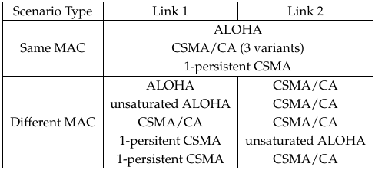
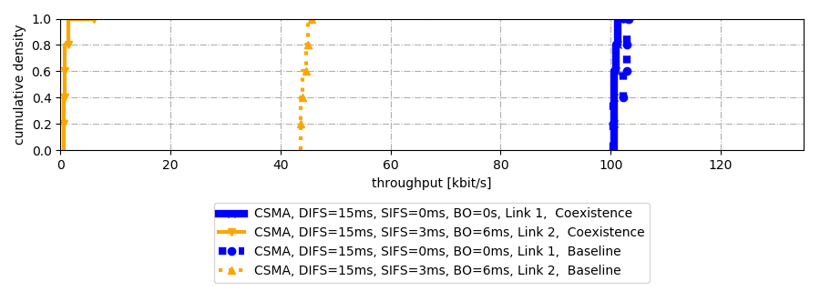
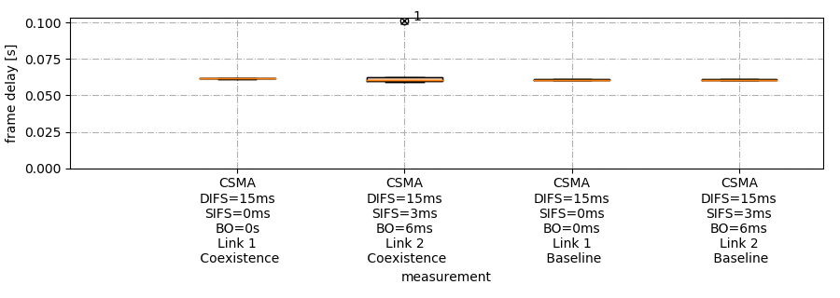
Contents
Motivation
Methodology
Results
Notes:
Contents:
Throughout the course of this presentation we will:
Motivate the thesis, i.e. what lead to the work and what was done
Describe the methodology, i.e. which devices an d software was used, the measurement setup and scenarios, the automatic script system to capture the results
Talk about the results and interpret them

Slide 3




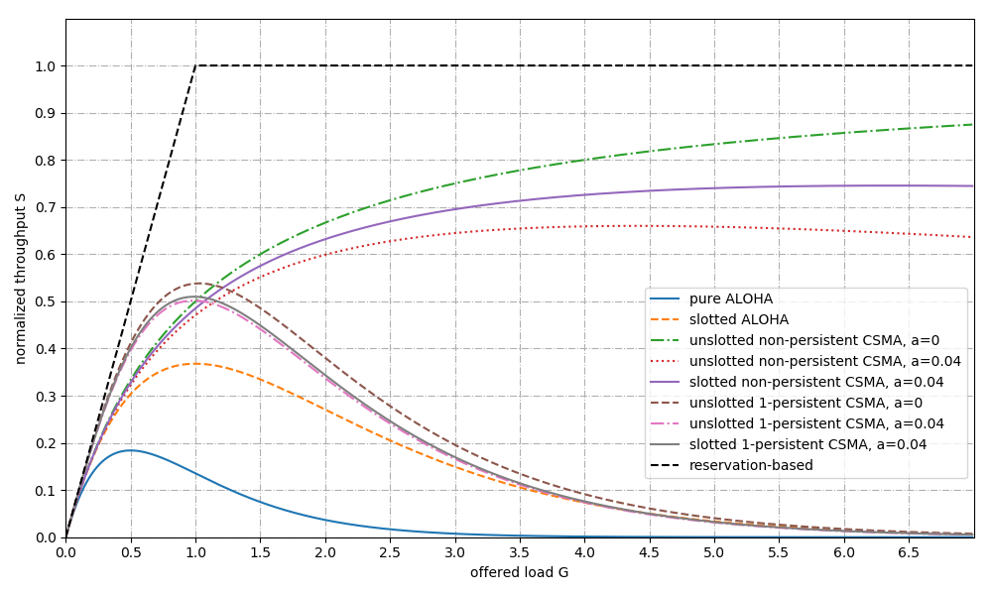
Motivation
Motivation
Notes:
Motivation I:
Network Densification, e.g. shopping mall or resturants, IoT, industry 4.0
Intertechnological Coexistence: Bluetooth, Wi-Fi, ZigBee, LTE in unlicensed bands
Theoretical Insights: Difference in performance of contention-based MAC protocols

Slide 4
Motivation
Motivation
Why is it hard to design good MAC protocols?
Design Drivers
Challenges Wireless MAC
Maximize
- Throughput
- Coverage
- Security
- Flexibility
- Hidden Node Problem
- Exposed Node Problem
- Interference
- Security
- Power Supply
Minimize
- Latency
- Jitter
- Power Consumption
- Complexity
Operating Conditions
- Intertechnological Coexistence
- Traffic Patterns
- Directional Traffic
⇒ Protocol design has to be confined/focussed on certain aspects depending on the application
Notes:
Motivation II - why is it hard to design good MAC protocols:
Design Criteria
Apart from the most obvious design criteria of maximizing throughput and minimizing latency...
Jitter in terms of first-order derivative of latency has to be low for some real-time applications
Flexibility in terms of adapting to new situations, e.g. varying traffic load
Power efficiency is important for devices that use battery as means of power supply (mention influence of physical layer => [spectral efficiency] = bits/W/Hz)
Complexity => bad predicatability, complicated mathematical models of performance aspects if any => motivation to use software defined radio
Overabundance of design criteria that are contradictory
power versus coverage (high TX power = high power consumption)
latency versus throughput (p-persistent CSMA)
throughput versus complexity (ALOHA)
security versus flexibility:
Challenges for wireless MAC
Wireless => Propagation in all directions around the origin => hidden / exposed node problem (hidden node problem = node cannot be heard by sender, but can interfere with transmission, exposed node problem = sender refrains from sending although exposed node cannot interfere with transmission in the region between recevier and sender ==> backup slides)
Related: Interference caused by hidden node problem / technologies without LBT
Security: low power signal jamming => reducing throughput and battery life

Slide 5
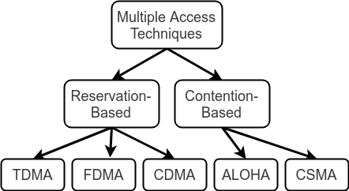
Motivation
Motivation
Protcol Classification
MAC Mechanisms
Coordinator
- Time Domain
- Frequency Domain
- Code Domain
Handshaking
- Acknowledgments
- RTS/CTS Exchange
- Timeouts
- Sliding Windows
Duty Cycles
- Fixed Length
- Adaptive Length
Carrier Sensing
- Thresholding
- Preamble Sampling
- Outlier Detection
Random Backoff
- Minimium CW
- CW Growth
Notes:
Classification of Mechanisms:
Classification of MAC Protocols
Duty cycling can be used as a power saving mechanism in WSN MAC protocols or as a coexistence mechanism for LTE in the unlicensed bands (LTE-U).

Slide 6
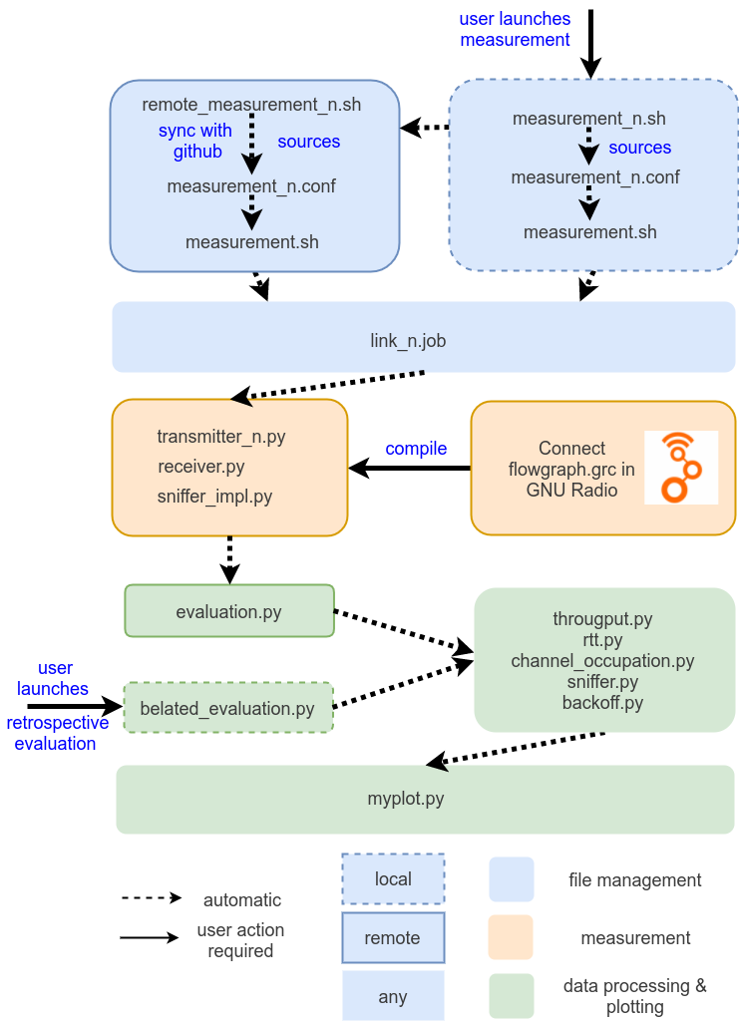
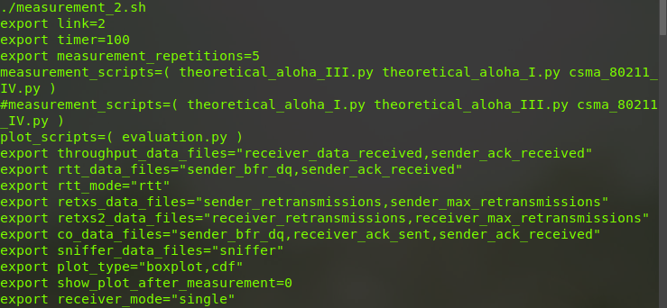
Methodology
Notes:
Devices
Two NI 2920 and two Ettus Research USRP2s
Receiver-Sender Pairs called links
Sniffer
Measurement Script system
File Management: Config files, Log files

Slide 7
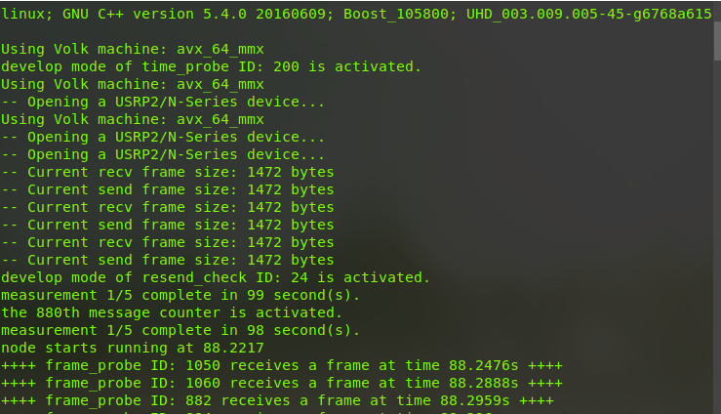
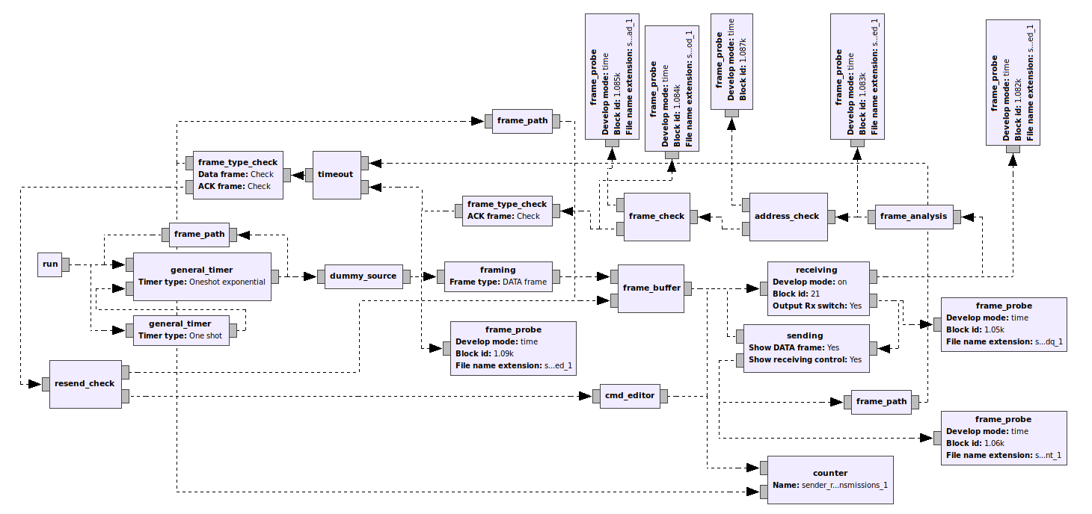
Methodology
Notes:
Measurement script system:
Compile GNU Radio flowgraph

Slide 8
Methodology
Sender (ALOHA) Flowgraph

Slide 9
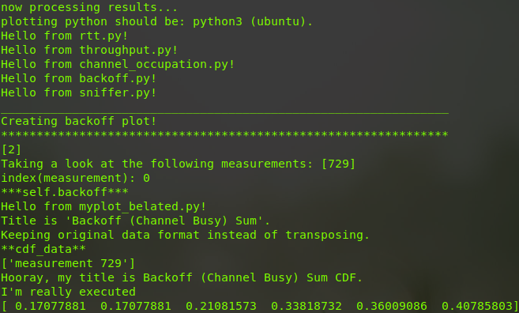
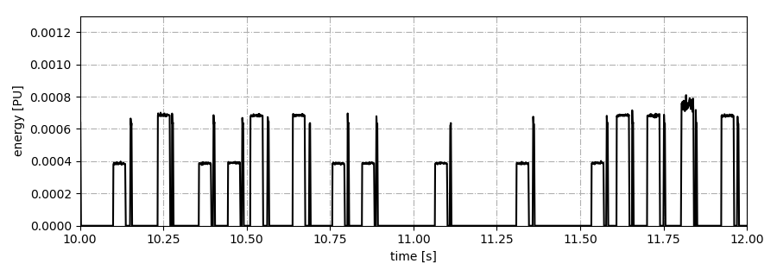

Methodology

Slide 10
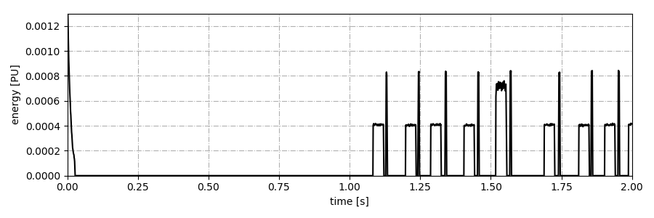
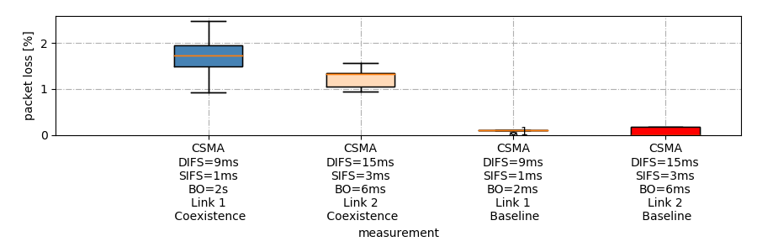
Methodology
Scenarios
Same MAC scenarios
Different MAC scenarios
1.1 s delay
<= 0.2% baseline packet loss

Slide 11
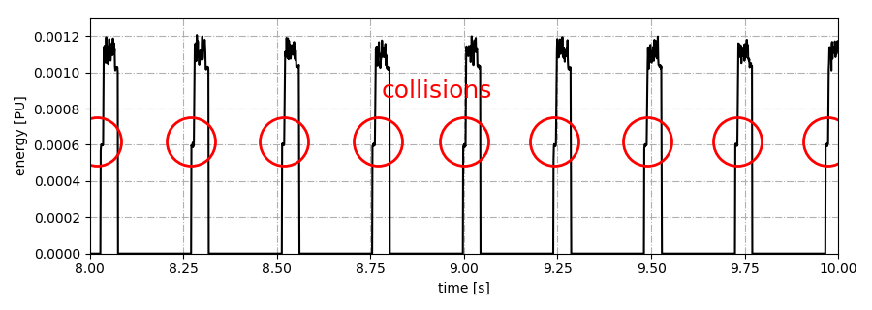
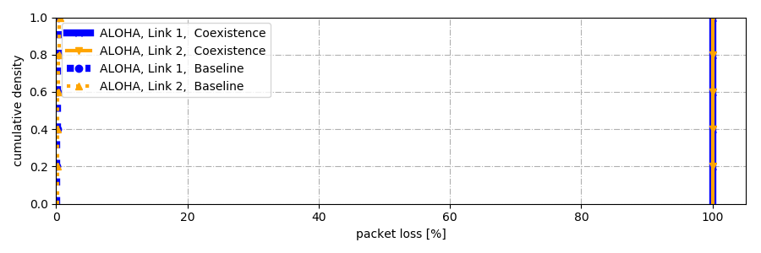
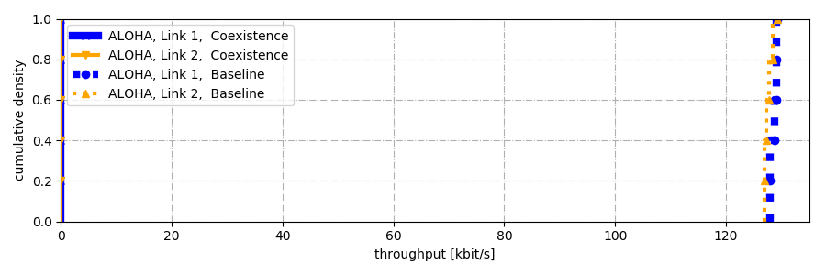
Results
Same MAC protocol on the two links - Pure ALOHA
Each and every frame collides
...
timeout 200ms
... leading to 100% packet loss
...
... and thus 0 throughput.
max. ≈ 135 kbps

Slide 12
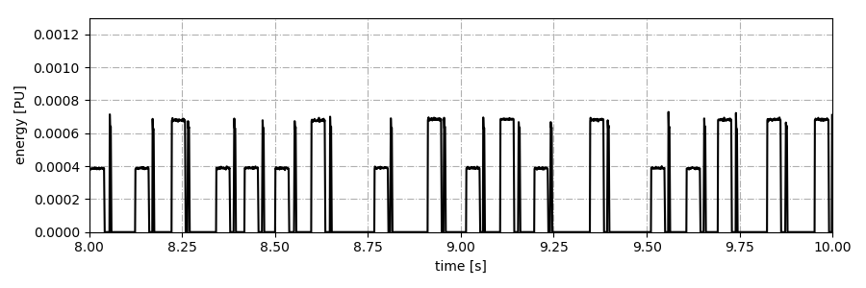
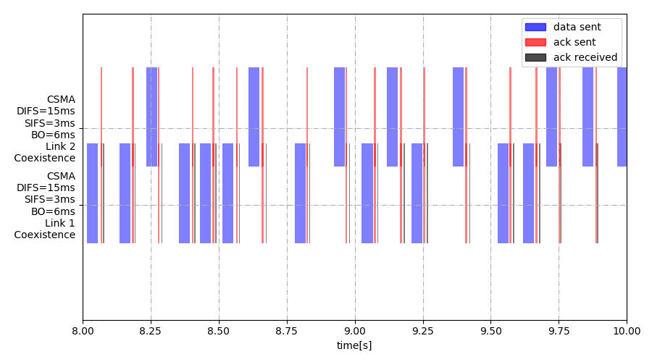
Results
Same MAC protocol on the two links - CSMA/CA high parameter values

Slide 13
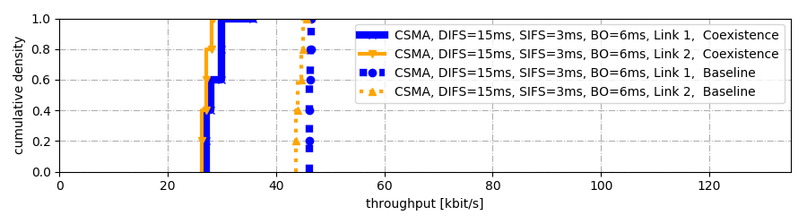
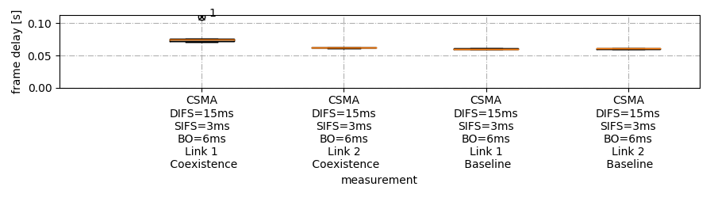
Results
Same MAC protocol on the two links - CSMA/CA high parameter values

Slide 14
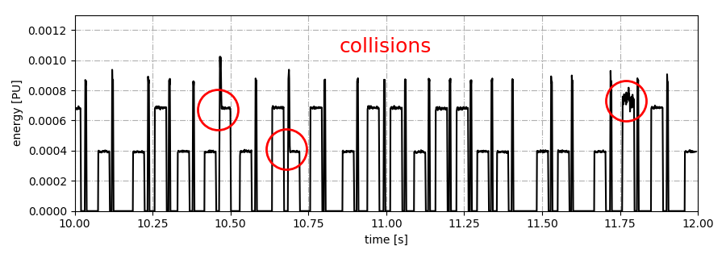
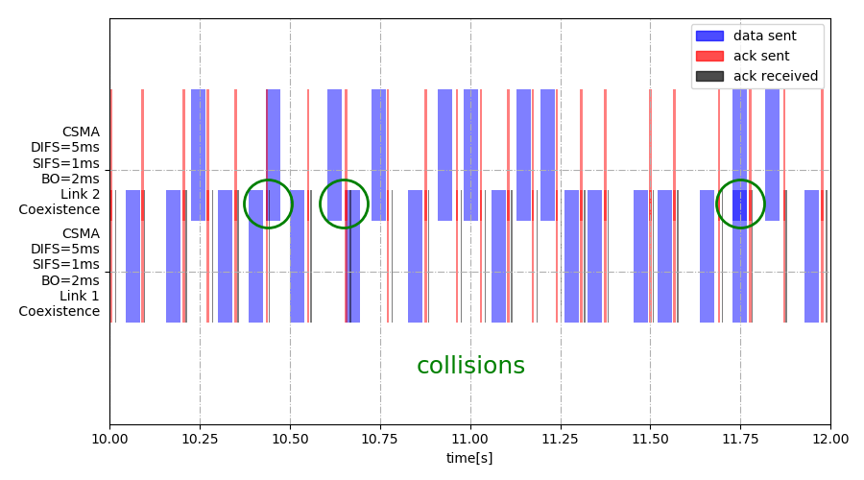
Results
Same MAC protocol on the two links - CSMA/CA low parameter values

Slide 15
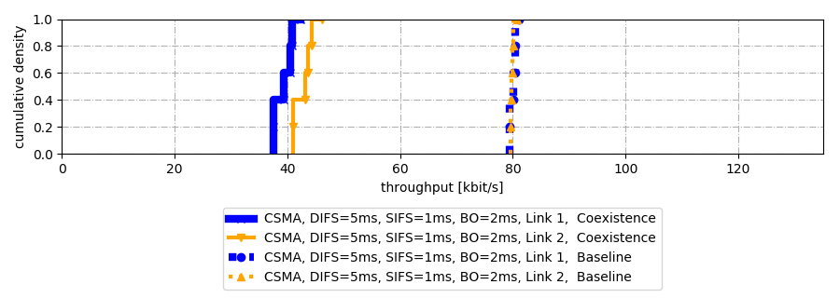
Results
Same MAC protocol on the two links - CSMA/CA low parameter values

Slide 16
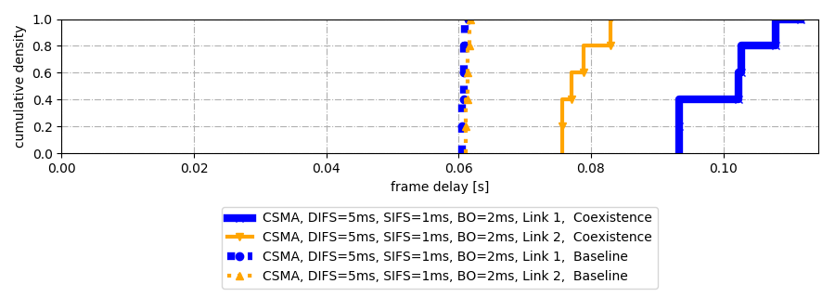
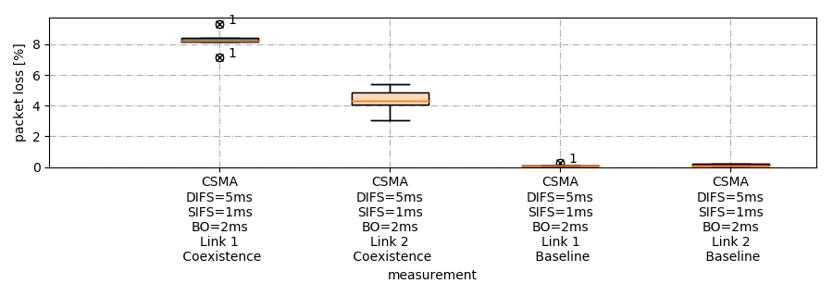
Results
Same MAC protocol on the two links - CSMA/CA low parameter values

Slide 17
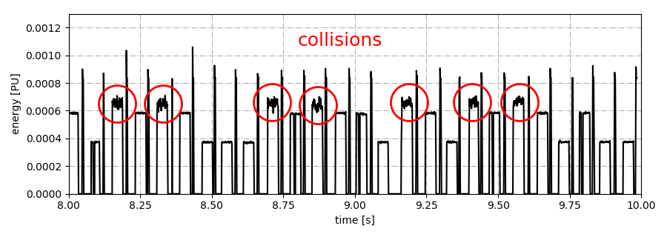
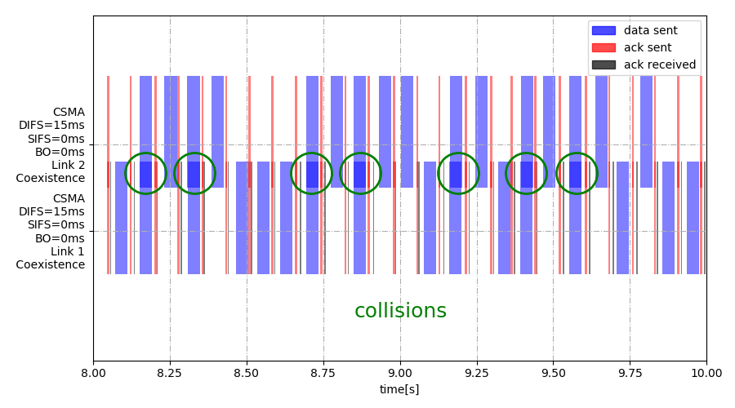
Results
Same MAC protocol on the two links - 1-persistent CSMA

Slide 18
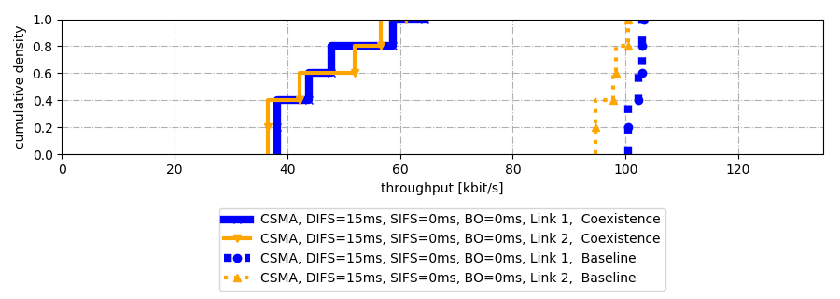
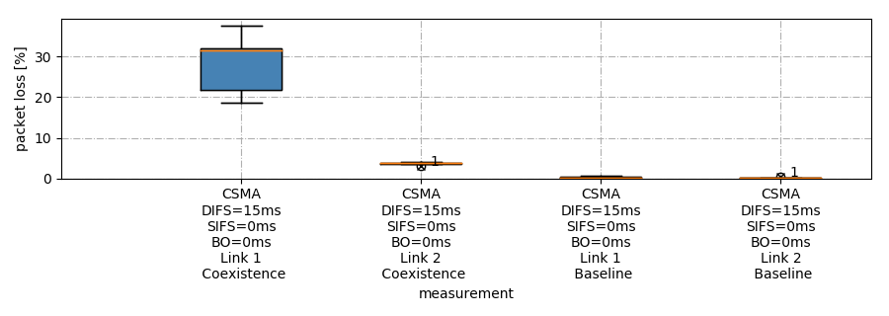
Results
Same MAC protocol on the two links - 1-persistent CSMA
high SINR versus low SINR

Slide 19
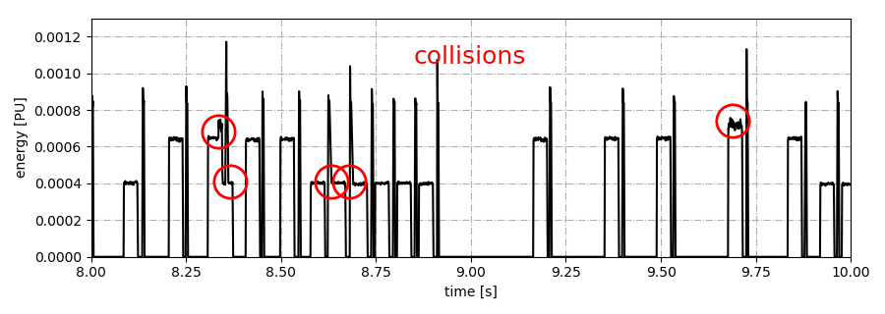
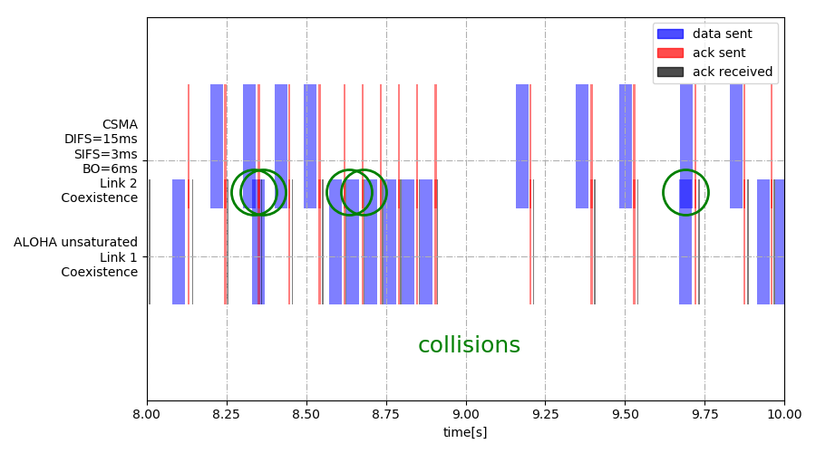
Results
Different MAC protocol on the two links - unsaturated ALOHA + CSMA/CA

Slide 20
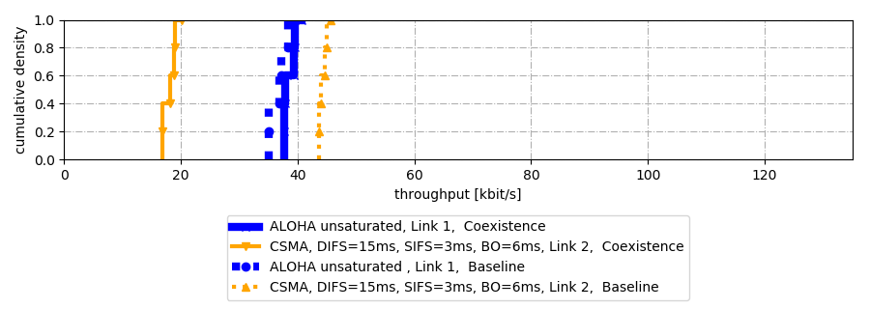
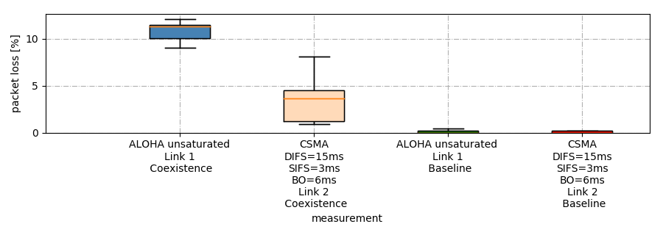
Results
Different MAC protocol on the two links - unsaturated ALOHA + CSMA/CA
LBT
versus
no LBT

Slide 21
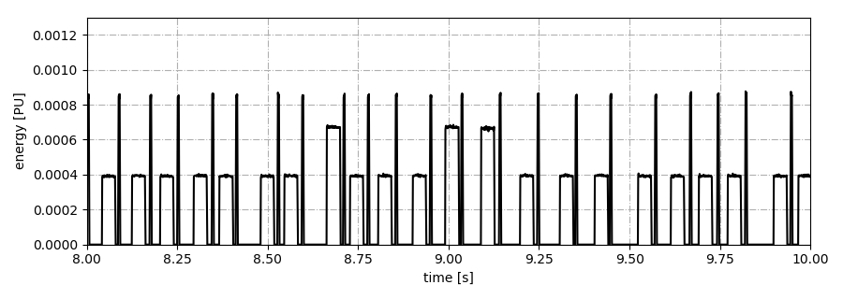
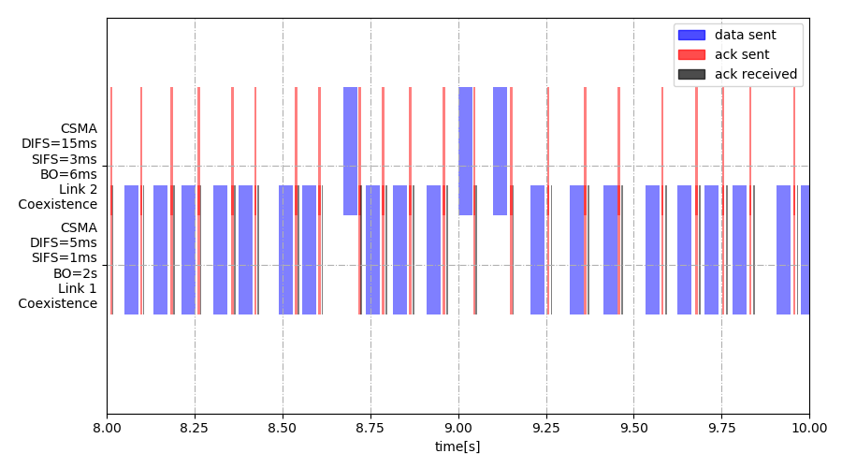
Results
Different MAC protocol on the two links - different CSMA/CA variants

Slide 22
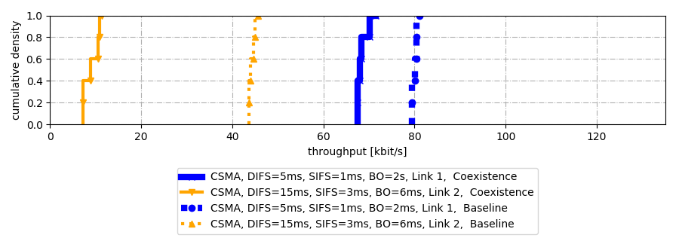
Results
Different MAC protocol on the two links - different CSMA/CA variants
Baseline
theoretical ≈ 1.85
measured ≈ 1.77

Slide 23
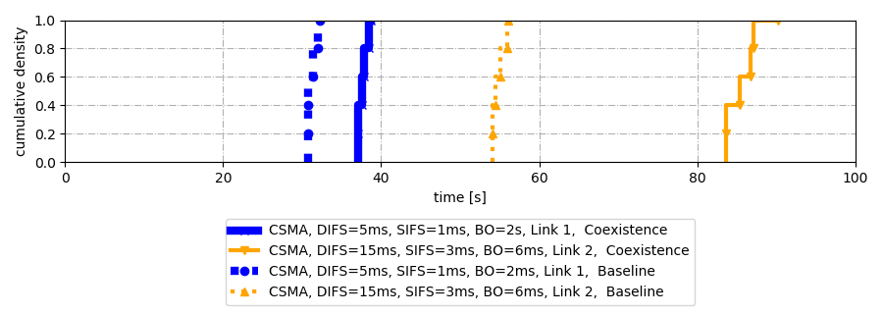
Results
Different MAC protocol on the two links - different CSMA/CA variants

Slide 24
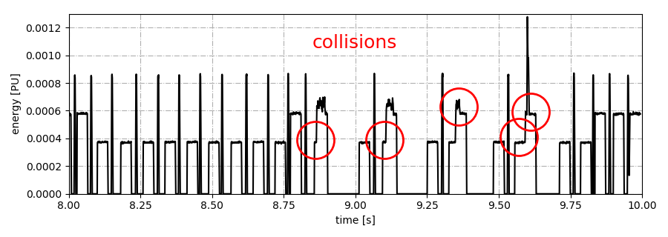
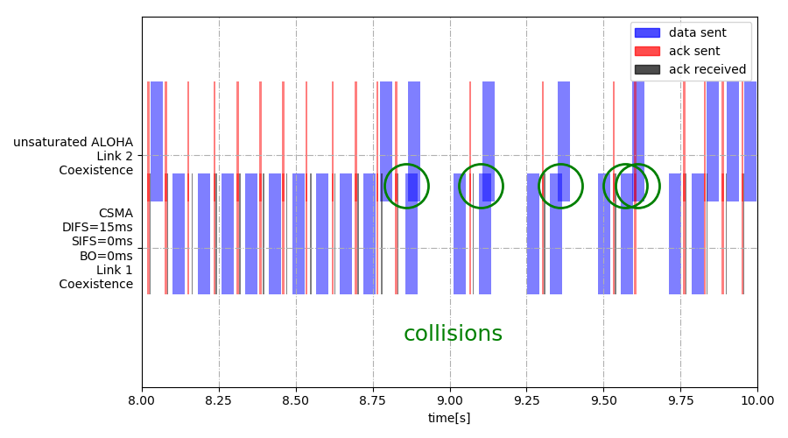
Results
Different MAC protocol on the two links - 1-persistent CSMA/CA + unsat. ALOHA

Slide 25
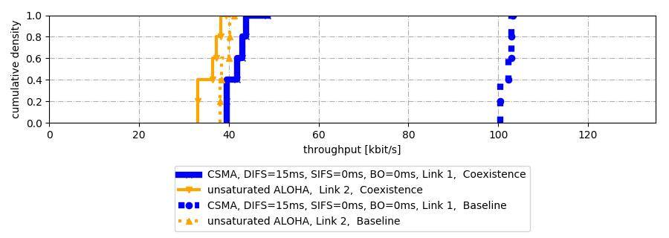
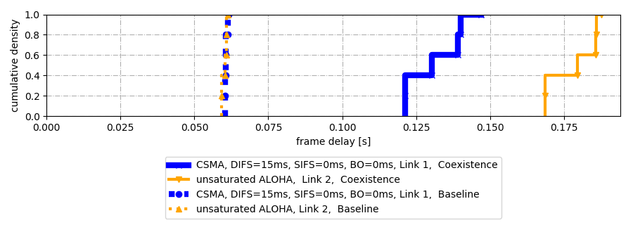
Results
Different MAC protocol on the two links - 1-persistent CSMA/CA + unsat. ALOHA

Slide 26
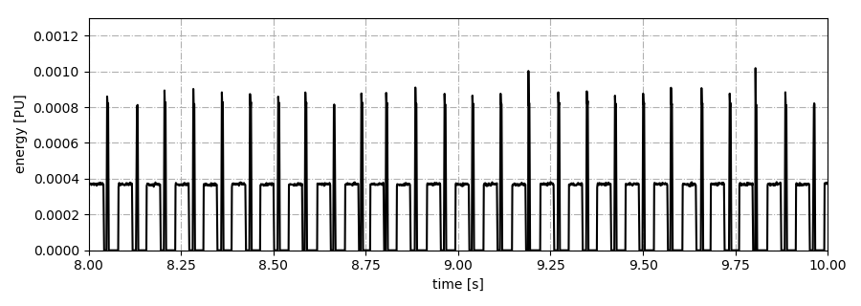
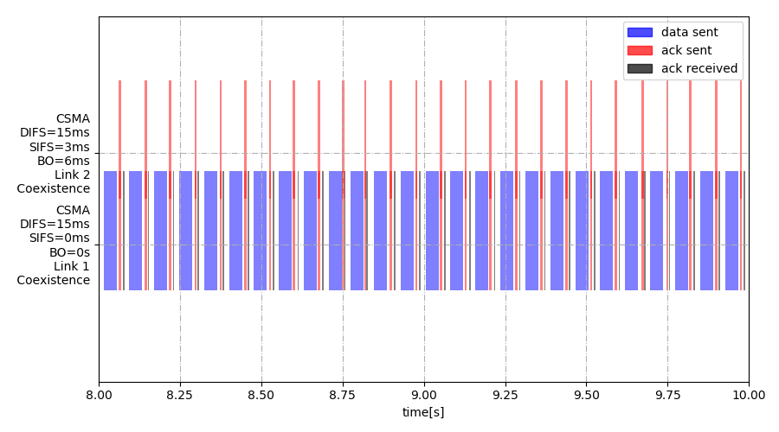
Results
Different MAC protocol on the two links - 1-persistent CSMA/CA + unsat. CSMA/CA

Slide 27
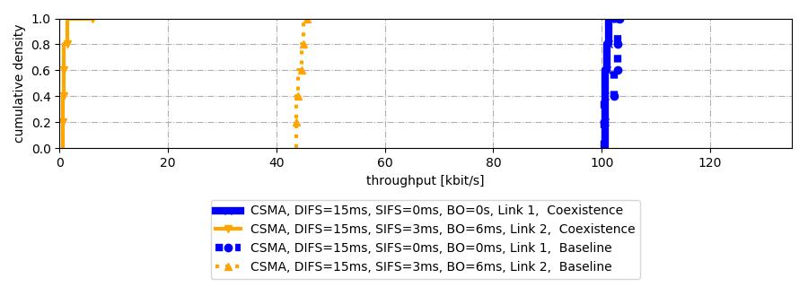
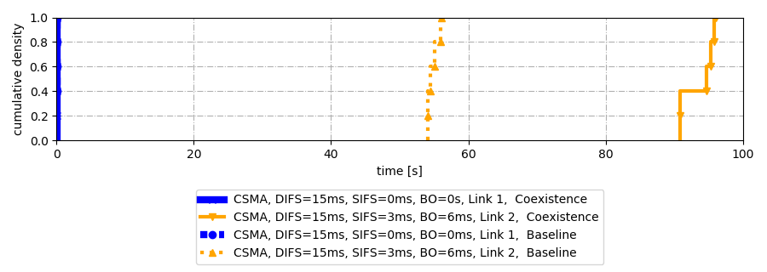
Results
Different MAC protocol on the two links - 1-persistent CSMA/CA + unsat. CSMA/CA

Slide 28

You with the interesting question!
Notes:
Contents:
Throughout the course of this presentation we will:
Motivate the thesis, i.e. what lead to the work and what was done
Describe the methodology, i.e. which devices an d software was used, the measurement setup and scenarios, the automatic script system to capture the results
Talk about the results and interpret them

Slide 29

Backup Slides

Slide 30
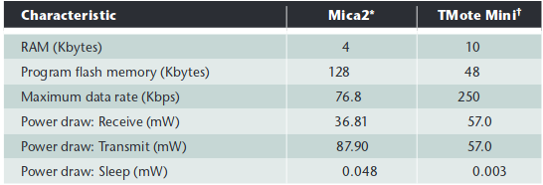
Motivation
Motivation
Security Aspects in MAC Design
Denial of Sleep Attack
Targetting: service availability and data integrity
Example attack against S-MAC: Bogus SYNC packets to keep clusters awake
Attacker: Repeated RTS to target neighborhood node
Interrogation Attack
Notes:
Other target: confidentiality

Slide 31


Methodology
Testbed Setup Parameters

Slide 32
Methodology
Sender (ALOHA) Flowgraph

Slide 33

Methodology
Sender (CSMA) Flowgraph

Slide 34


Methodology
Sniffer+Receiver Flowgraph

Slide 35


Results
Same MAC protocol on the two links - CSMA/CA with medium parameter values

Slide 36


Results
Same MAC protocol on the two links - CSMA/CA with medium parameter values

Slide 37


Results
Different MAC protocol on the two links - saturated ALOHA + CSMA/CA

